Slide 1
Medieval Power
Key people
Key terms
Key events
 | Henry II (reigned 1154-1189) King of England from 1154 until his death in 1189. He believed the Church had too much power, so challenged this. Responsible for the death of Thomas Becket. King John (reigned 1199-1216) The second son of Henry II. John was very unpopular. In 1215, John was made to sign the Magna Carta by his barons – which limited his power. Henry III (reigned 1216–1272) The son of King John. He tried to break the terms of Magna Carta, which led to a rebellion. He was forced to agree to the setting up of a Parliament.
 | Thomas Becket Became Archbishop of Canterbury in 1162. Before this, was good friends with Henry II, however the two men clashed over their different ideas about the role of the Church. He was killed in 1170. Simon de Montfort Known also as ‘The Father of Parliament’. One of the leading barons in England. Captured Henry III at Battle of Lewes and called a Parliament in 1265
The Medieval Church | Churches were important as meeting places – most people went to Church at least once a week. In 1066, there were around 1000 monks. By 1300, there were over 12,000 monks in England. Ideas about Heaven/Hell were very important to people. People lived their lives following the Church’s rules so they’d go to heaven when they died. Hospitals were run by priests not doctors – people used prayer to cure illness not medicine. This included Black Death, where people whipped themselves to say sorry to God.
Henry II challenged the power of the Church. | Henry II tried to limit to power of the Church by passing the Constitutions of Clarendon. Archbishop Thomas Becket was very unhappy about this, leading to the two men clashing. Due to this, Henry II supposedly organised for Becket to be killed. Henry was punished by the Church for this. He had to give up on the Constitutions of Clarendon and was whipped by monks. Thomas Becket was canonized and became a saint.
King John and Magna Carta | King John was very unpopular in England. He charged high taxes, offended his barons and tried to interfere in religious matters. John was excommunicated by the Pope which stopped all religious services in England for 7 years. His Baron’s made John sign Magna Carta (the Great Charter) setting out the rights that they had.
Henry III, Simon de Montfort and Parliament | John’s son; Henry III, also had arguments with his baron’s. Henry tried to raise taxes to fight in the Pope’s Holy Wars, often without asking his barons. One of his barons, Simon de Montfort, forced Henry to sign the Provisions of Oxford. When Henry broke the Provisions of Oxford, de Montfort led a rebellion against the king. Henry was captured and Simon de Montfort called England’s first parliament consisting of 2 commoners from each region. This became known as the House of Commons.
Monarchs:
The Church. | Means all of Christianity in England, not just one building. This means the Catholic Church in Rome in the Medieval Period.
Catholicism | A type of Christianity led by the Pope in Rome.
Excommunicate | The Pope officially exclude (someone) from participation in the sacraments and services of the Christian Church
Flagellation. | The act of whipping oneself to say sorry to God.
Magna Carta | A document signed by King John which sets out in law the power of the English king.
Monasteries | A building where monks live and work together. Henry VIII destroyed these during the Dissolution.
Martyr. | Someone who dies standing up for their religion. They’re celebrated by their religion.
Parliament | An elected group who a monarch consults in the running of the country.
Priest | A religious leader in charge of performing religious ceremonies in churches.
Churchmen and Barons
S
Signing of Magna Carta
Henry III tries to break terms of Magna Carta
The first Parliament is called by Simon de Montfort
Murder of Thomas Becket
h
E
Timeline
Henry II brings in Constitutions of Clarendon
John becomes King of England.
John dies and his son Henry becomes king
Provisions of Oxford signed
.
Death of Henry III
11
1164
1170
1198
1215
1216
1258 1258 1264 1272

Slide 2
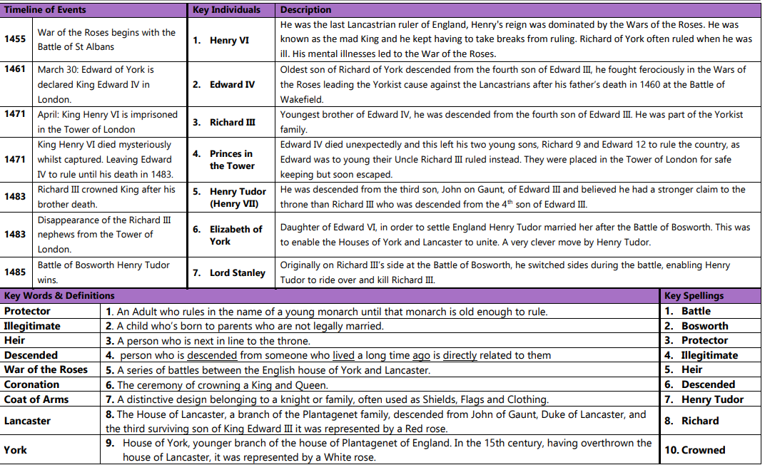

Slide 3
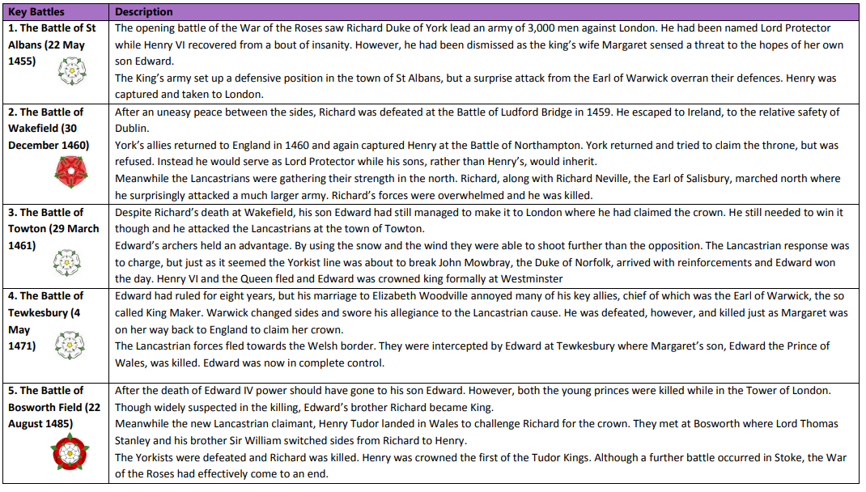

Slide 4
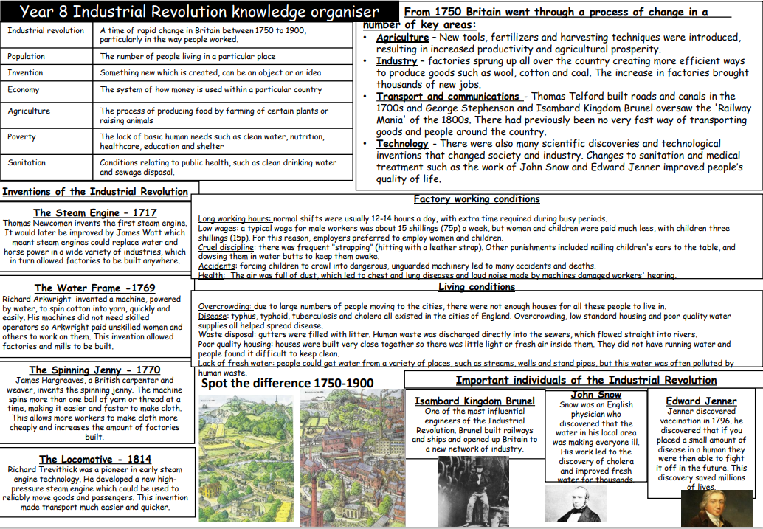

Slide 6
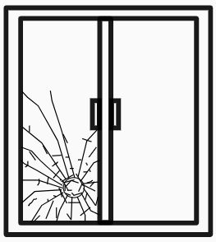
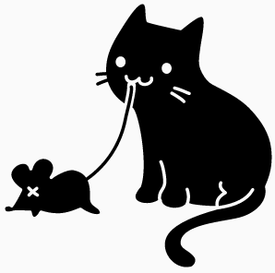
Women’s Suffrage
Key people
Key terms
Key events
Mary Wollstonecraft (1759-1797) Author, philosopher and advocate of female rights. She published “A vindication of the rights of women” which is considered one of the earliest feminist works.
Millicent Fawcett (1847-1929) Political activist for female suffrage. She established the National Union of Women’s Suffrage Society (NUWSS) also known as Suffragist Movement.
Emmeline Pankhurst (1858-1928) Activist for female suffrage who became disheartened with slow progress of NUWSS and established the Women’s Social and Political Union (WSPU) known as the Suffragette Movement.
Nancy Astor (1879-1964) American-born politician; the first female elected MP to take their seat in Parliament.
David Lloyd George (1836-1945) British Home Secretary, later Prime Minister during the First World War. Met regularly with female suffrage campaigners, repeatedly promising suffrage.
Domestic Sphere |  | 19th century women were expected to stay at home, caring for the family.
Suffrage |  | The right to vote; originates from Latin ‘suffragarium’ which is a voting tablet.
National Union for Women’s Suffrage |  | NUWSS or Suffragist movement.
Petitioning |  | Writing to MPs request something
Women’s Social and Political Union |  | WSPU or Suffragette movement. Exasperated by lack of movement, the Suffragette movement turned to violence, with a slogan of “Deeds not words”.
“Deeds not words” |  | Slogan of the Suffragette movement, used to incite violence.
Civil disobedience |  | Acts of protest ranging from chaining to railings to violence such as destruction of property and arson.
Cat and Mouse Act (1913) |  | Law releasing imprisoned Suffragette’s who were hunger striking.
Home Secretary |  | Political position in UK government responsible for elections/electorate.
Martyr |  | Someone who is killed for their beliefs.
Women in 19th century
Women in 19th century Britain were very much second class citizens, compared to men. Women had fewer rights than men in areas like property, divorce rights and voting rights. Women were thought to be unsuitable for political decisions Women’s work included areas such as factory work, secretaries, teaching, working with textiles. Women were not invited to work in business, politics or finance. Middle and upper-class women rarely worked. Working-class women often had no choice. Women were expected to give up work when they got married to care for the home.
Millicent Fawcett established the NUWSS in 1897. Their aim was female suffrage achieved through peaceful means. They wrote pamphlets and articles, petitioned MPs and went on marches. The peaceful nature of the suffragists was easy for government to ignore. Some in the movement felt the suffragist movement was too tame. In 1903, Emmeline Pankhurst established the Suffragette movement (WSPU) who’s slogan became “deeds not words”. Suffragette protests became more violent with acts such as smashing shop windows, blowing up letter boxes, cutting communication wires, blowing up the Prime Ministers house. The aim was for suffragette acts to gain media attention.
1910 – Black Friday. Violent clashes between police and suffragettes. As Suffragette acts became more violent, the government took a harder line against them. Suffragettes were imprisoned for their actions, but were not treating as political prisoners (treated differently). Suffragettes in prison went on hunger-strike, protesting against not being seen as political prisoners. The government passed The Cat and Mouse Act (1913) which released hunger-striking suffragettes, to be recaptured when they regained strength.
Suffrage movement
Suffrage; from peaceful to violent
Other key figures
Suffragette vs. Government
WSPU set up by Emmeline Pankhurst
Black Friday – violent clashes between police and suffragettes
Emily Wilding Davison jumps in front of kings horse
World
War One is declared in Europe
WSPU
NUWSS set up by Millicent Fawcett
Suffragette newspaper is published
Suffragette actions become violent
Cat and Mouse Act is passed
Representation of the People Act – some women given right to vote
Timeline
NUWSS
Help or hinder?
Helped Suffragist easily ignored. Grabbed media attention – increased support. Showed desperation of women for suffrage. Scared the government into action. | Hindered Some public opinion turned against Suffragette. Why should they get a voice if break laws? Government action becomes harsher
1897
1903
1904
1910
1911
1913
1913
1914
1918

Slide 7
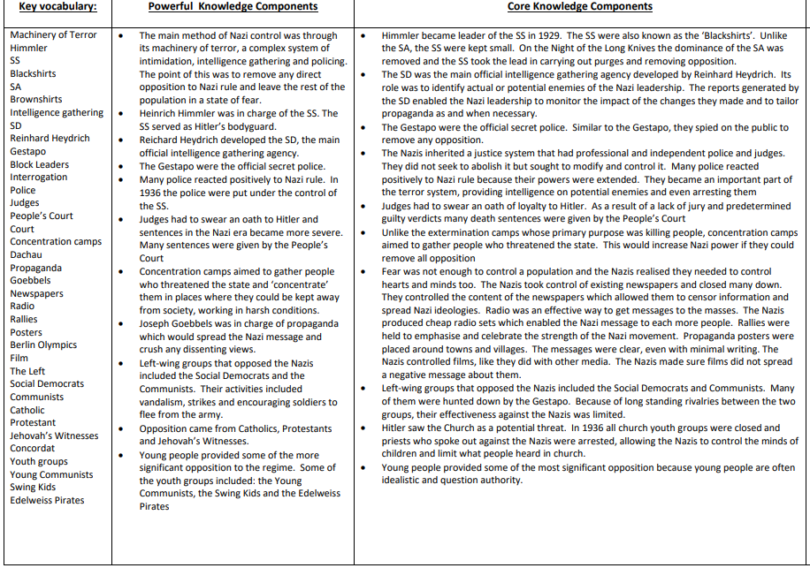
Knowledge organiser: Life in Nazi Germany

