Slide 1
Careers at Christmas
Advent Calendar

Slide 2
1
16
10
22
6
20
18
7
23
12
4
9
11
21
15
2
17
13
3
14
8
19
5
24

Slide 3
Careers at Christmas
Day 1
There are lots of important careers that help to make our Christmas celebrations happen. Race to crack the codes and find some of careers that help make Christmas run smoothly!
3.33.555.444.888.33.777.999 3.777.444.888.33.777
777.33.8.2.444.555 9.666.777.55.33.777
9.2.444.8.33.777
222.44.777.444.7777.8.6.2.7777 33.555.333
7.666.7777.8.2.555 9.666.777.55.33.777
222.44.33.222.55.666.88.8 666.7.33.777.2.8.666.777
8.666.999 3.33.7777.444.4.66.33.777
22.88.8.222.44.33.777
333.2.8.44.33.777 222.44.777.444.7777.6.2.7777
Click me to return to the advent calendar!
A. Delivery Driver B. Retail Worker C. Waiter D. Christmas Elf E. Postal Worker F. Checkout Operator G. Toy Designer H. Butcher I. Father Christmas
Show Answers

Slide 4
Careers at Christmas
Day 2
You are working as a Sales Assistant in a big department store. You’ve had the call that Santa Claus is arriving to see the children at the weekend!
Your manager has asked you to design some festive activities for the children to do while they see and wait to see him with their Christmas list.
Can you come up with at least three fun festive ideas that the children could do while they wait to see Santa?
Click me to return to the advent calendar!
Festive colouring sheets. Christmas carol singing. Christmas paper chain making. Paper snowflake making. Letter writing so they can pass their letter to Santa. Christmas puzzles e.g. word searches or crosswords etc.
See suggestions

Slide 5
Careers at Christmas
Day 3
You are a Baker making mince pies for a stand at the town’s big Christmas lights switch on.
Your recipe makes enough for 15 people. But 525 people are expected to attend the event.
How much of each ingredient must you order for the event?
Bonus Challenge: If your usual recipe costs £5.75 per batch, how much do you need to budget for the event?
225g cold butter
350g plain flour
100g caster sugar
280g mincemeat
1 small egg
Main
Answer
Bonus
Answer
Butter 7875g
Flour 12,250g
Sugar 3,500g Mincemeat 9,800g
35 small eggs
Click me to return to the advent calendar!
£201.25

Slide 6
Careers at Christmas
Day 4
Santa Claus crosses all of the continents and through all 195 countries of the world on his Christmas Eve journey. He also receives letters from children around the world so it is important that he is able to speak all of the languages!
Work as a class to write “Merry Christmas” in as many languages as you can!
See if you can come up with more than five and then try to learn to say each of them.
See examples
عيد ميلاد مَجيد (Aiyeed milad sayeed) - Arabic Feliz Navidad – Spanish
Joyeux Noël – French Frohe Weihnachten – German
Buon Natale – Italian Prettige Kerstdagen – Dutch
Feliz Natal – Portuguese God Jul – Swedish & Norwegian
圣诞节快乐 (shèngdàn jié kuàilè) - Mandarin Qismas Botivjaj - Klingon!
Click me to return to the main calendar!

Slide 7
Careers at Christmas
Day 5
You are the General Manager of a new business that offers people the chance to hire a Christmas tree. The customer chooses a potted tree which they then take home.
After the festive period is over, the customer returns the tree and it is replanted so that it can be used again next year.
You receive a call from the local newspaper who are running a story on this innovative new scheme. They want to know what the advantages are and why customers should use it.
Can you describe three advantages of this scheme?
Click me to return to the advent calendar!
1. Cut trees usually end up in landfill and release methane as they rot.
2. Artificial trees are made of plastic which requires oil and energy to create.
3. Replanting the trees means they can continue to remove carbon dioxide from the atmosphere as the tree photosynthesises.
See suggestions

Slide 8
Careers at Christmas
Day 6
You are a Graphic Designer working for a large greetings card manufacturer.
You have been asked to design a Christmas card aimed at customers buying it for their pets.
Can you come up with a fun design and a catchy message to put on the front of the card?
Hint: you could include alliteration or a joke to make it funny!
Click me to return to the advent calendar!
8% of all owner’s send their pet a card each Christmas - and 75% of dog owners buy their pooch a Christmas present!
See Fun Facts!

Slide 9
Careers at Christmas
Day 7
You work as an Electrician for the local council and are responsible for ensuring that all of the Christmas street lighting is correctly installed so it works for the big switch on!
The lights you are using have been imported from another country and the instructions are not in English. But luckily there is a wiring diagram for you to follow.
Can you name each the components shown in the diagram?
Click me to return to the advent calendar!
Show Answer
Battery/Cell, Wire, Lightbulb, Motor, Open Switch, Closed switch

Slide 10
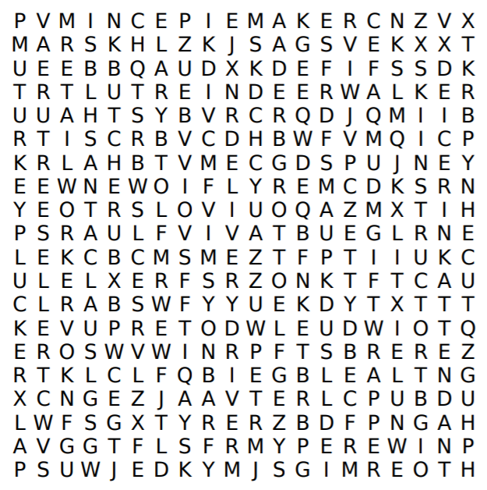
Careers at Christmas
Day 8
Find the 12 Christmas jobs!
Either work as a whole class to complete the word search, or work in pairs and race to be the first to write down all 12 Christmas jobs!
Show Answers
Ice Rink Attendant Reindeer Walker Delivery Driver
Ski Instructor
Mince Pie Maker
Retail Worker
Gift Wrapper
Turkey Plucker
Santa Claus
Tree Seller
Grotto Elf
Butcher
Click me to return to the advent calendar!

Slide 11
Careers at Christmas
Day 9
You are the Head Chef at a large hotel. Tonight is your busiest night of the year as there are more than 300 people who have booked for Christmas parties.
The guests have chosen from a set menu with the most popular choice the traditional Christmas dinner with turkey. You have arrived early to work out how long the turkey needs to cook so that it will be ready for the guests to arrive at 8pm.
What time do you need to put the turkey in if the label shows the following information?
Cook for 20 minutes per kg plus an extra 30 minutes. Turkey Weight: 14.5kg
Click me to return to the advent calendar!
The cooking time is 320 minutes or 5 hours 20 minutes - so the turkey needs to go in the oven at 2.40pm at the latest.
Show Answer

Slide 12
Careers at Christmas
Day 10
You are a Play Worker on a children’s hospital ward. Some of the children on the ward might need to stay in hospital over the Christmas period which can be challenging for them and their family.
Can you think of any ways that you could brighten up the ward for them - and any festive activities you might be able to organise to entertain them over Christmas?
Get them to make decorations to hang around the ward and in the communal areas. Have a Christmas jumper day. Invite Father Christmas to visit the children with their parents. Make sure there is a Christmas tree for gifts to be left under. Host a party and play games and music. Have the non-medical staff dress up in Christmas outfits.
See suggestions
Click me to return to the advent calendar!

Slide 13
Careers at Christmas
Day 11
The new must-have toy on everyone’s Christmas list is made in China and then distributed around the world to be sold to children in toy stores.
It involves many different people to take a product from being an idea to becoming a finished product on the shelves.
Work as a class to name as many different careers as you can that are part of this journey.
See if you can come up with more than 15 careers involved in the journey!
Click me to return to the advent calendar!
Toy designer, graphic designer, design engineer, product tester, quality inspector, manufacturer, product packer, delivery driver, logistics manager, warehouse manager, airport staff, pilot, ship captain, customs officer, buyer, retail store manager, retail assistants, store merchandiser, sales assistant, checkout operator.
See suggestions

Slide 14
Careers at Christmas
Day 12
You are a Food Scientist working for a supermarket to create delicious new food products.
The supermarket have asked you to design a new festive cake that can go into production and be on the shelves for Christmas. They would like it to be large enough to serve up to 12 portions. It needs to be fun, have a festive flavourings and look spectacular!
Channel your inner Bake Off skills and design a showstopper cake to meet this design brief.
Your teacher will decide which festive cake looks the most delicious and then click below to reveal some Christmas food fun facts!
Click me to return to the advent calendar!
Early mince pies actually included minced meat and the original Christmas pudding was made with beef and mutton. Peacock and boar was the tradition Christmas meat until Henry VIII ate turkey and started the new tradition. The typical Christmas dinner includes 7,000 calories per person!
See Fun Facts

Slide 15
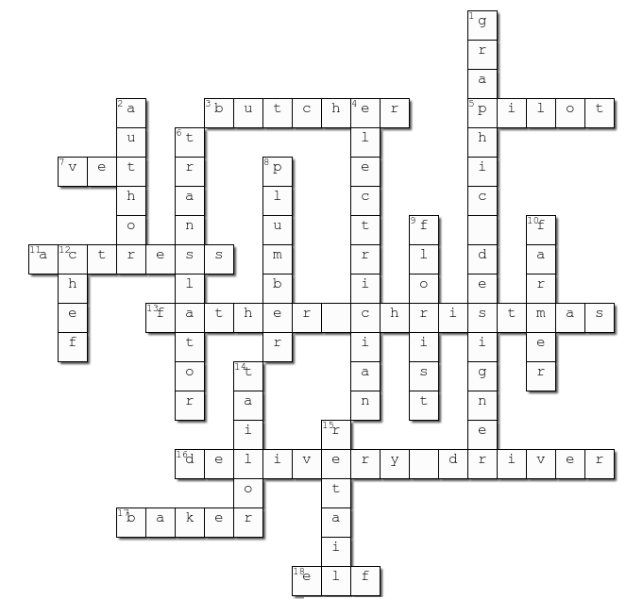
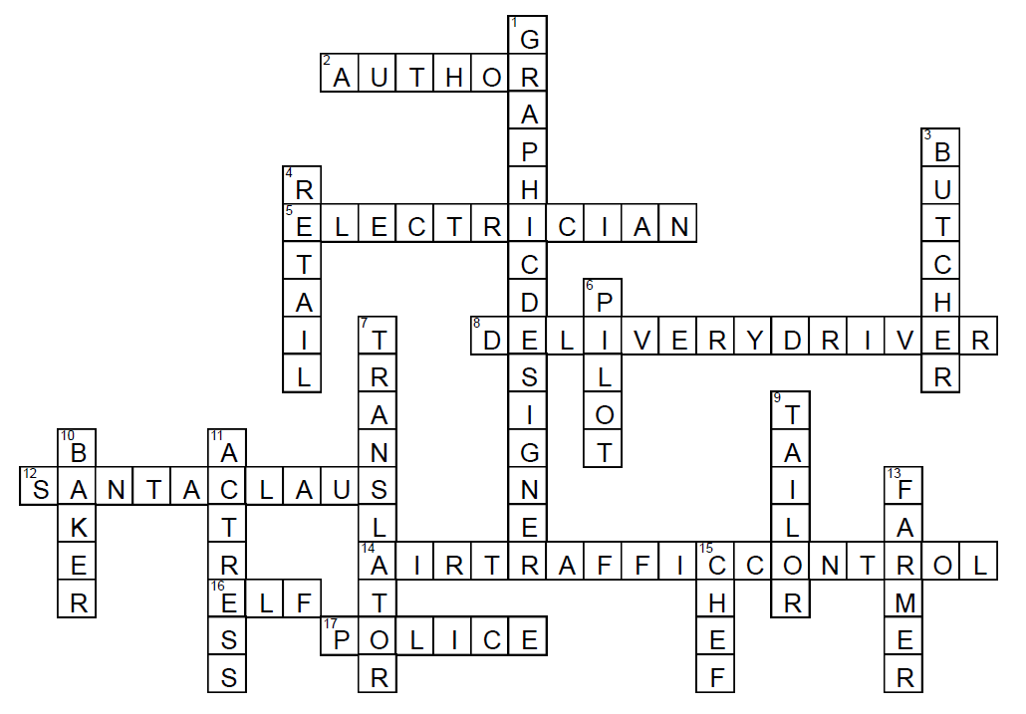
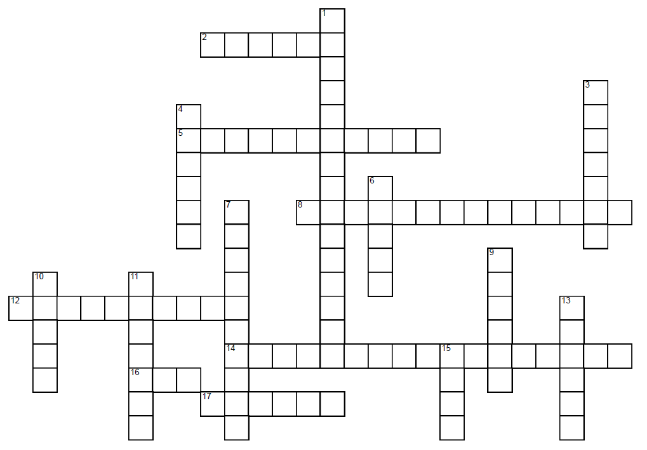
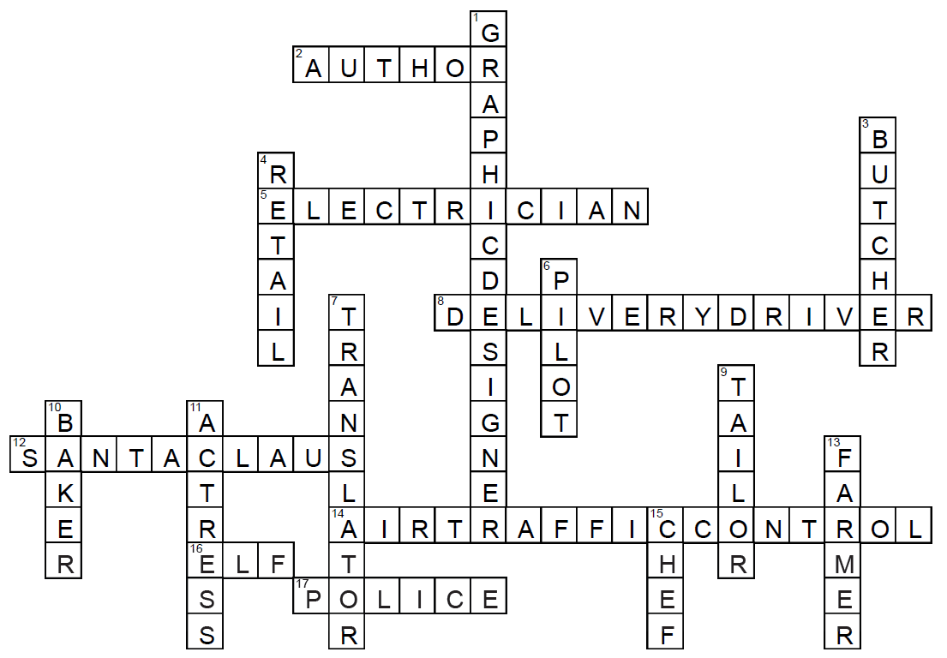
Careers at Christmas
Day 13
Click here to return to advent calendar
ACROSS
2 Charles Dickens, Raymond Biggs and Dr. Seuss are all famous examples of this (6)
5 The Christmas lights need to be checked by this person before the big switch on! (11)
8 Your Christmas food shop might be dropped off at your door by one of these (8,6)
12 He wears a red suit, has a white beard and drives a sleigh for a living (5,5)
14 These people will monitor Santa as he enter the country's airspace on Christmas Eve (3,7,6)
16 An expert in wrapping, toy making and bringing festive cheer (3)
17 The bad guys in Home Alone pretend to be one of these (6)
DOWN
1 They design Christmas cards and gift wrap before it goes into production (7,8)
3 This person might encounter Santa flying high above the clouds on Christmas Eve! (7)
4 Busy Christmas shops belong to this sector of the world of work (6)
6 This person might encounter Santa flying high above the clouds on Christmas Eve! (5)
7 If Santa needs help reading the languages in some of the letters he receives he might call one of these (10)
9 If Santa needs his suit adjusting he'll need one of these (6)
10 This person keeps us supplied with freshly baked mince pies (5)
11 Cinderella in the Pantomime will be played by one of these (7)
13 This person grows and harvests sprouts for you to enjoy for Christmas dinner! (6)
15 They're busy cooking a lot of Christmas dinners for their guests (4)
Instructions: Either work as a whole class to complete the crossword, or work in pairs and race to be the first to solve all the Christmas clues!
Click to reveal the answers when you have finished!

Slide 16
Careers at Christmas
Day 14
Some of the unsung heroes of Christmas are Delivery Drivers. They often work long hours and often have tight schedules to stick to so that all of their deliveries are made on time.
You are the Logistics Manager of the local delivery hub and you have noticed a lot of the delivery drivers are struggling with the heavy workload in the lead up to Christmas. You decide that you need to try and improve their morale.
Come up with three ways to help keep the driver’s motivated and feeling appreciated.
Click me to return to the advent calendar!
Provide them with hot meals at the transport hub, ensure they have healthy snacks available, give out free bottles of water so they stay hydrated, offer vouchers or rewards for any positive customer feedback, make the hub as festive as possible with music and decorations, run fun competitions to incentivise their work.
See suggestions

Slide 17
Careers at Christmas
Day 15
You are a Leader of the Council and are you keen to help support your community to be more sustainable. Lots of people have approached you following the COP26 climate summit to see how the council will help residents to reduce their carbon emissions.
You decide to publish an article in the local paper to give people some handy hints for having a more sustainable Christmas.
What advice would you give them?
Recycle your tree or use a tree rental scheme instead. Turn Christmas lights off when not at home. Buy presents that are sustainable. Recycle any batteries you use. Use vegetable peelings to make compost. Use brown paper as gift wrap as printed wrap is difficult to recycle. Only buy what you or others really need to prevent waste. Gift people experiences rather than things.
See suggestions
Click me to return to the advent calendar!

Slide 18
Careers at Christmas
Day 16
Santa’s elves have got all in a jumble! They’ve accidentally scrambled the names of these famous Christmas characters and need your help to unscramble them so Santa knows where to make his deliveries this Christmas…
1. CKAJ LINSELTGONK 2. BEEEZERN RECSOGO 3. HET CRIGHN 4. AKJC TORSF 5. IVNEK CRILMCLEAST ← this one is extra hard! 6. OHPLUDR
Click me to return to the advent calendar!
1. Jack Skellington 2. Ebenezer Scrooge 3. The Grinch 4. Jack Frost
5. Kevin McCallister 6. Rudolph (Santa wouldn’t forget his favourite reindeer!)
Show Answers

Slide 19
Careers at Christmas
Day 17
Christmas is a very busy time in lots of sectors. One of the busiest of all is the retail sector.
As Store Manager of a candle shop you have decided to sell gift hampers to increase sales.
The hamper will include the following items: 3 large jar candles worth £12.50 each, two Christmas pine container candles worth £6.49 each, one festive Frankincense candle worth £10.99, four wax bars worth £4.95 each and three Home Scent oils worth £8.25 each.
You then want to apply a 20% discount to make it worthwhile for customers to buy the items in bulk in the hamper.
What would be a suitable price to charge for the hamper?
Click me to return to the advent calendar!
£37.50 + £32.45 + £10.99 + £19.80 + £24.75 = £125.49. With a 20% discount applied, it would be £100.39 so £99.99 would be a suitable price.
Show Answer

Slide 20
Careers at Christmas
Day 18
You are a Drama Facilitator working in schools to improve literacy outcomes through creative workshops and dramatic storytelling.
One of the warm up exercises you often do is to get students to create a story chain - where each student adds one word at a time to build a creative story.
Working in small teams, create a story chain on the theme of Christmas. Remember, each player can only add one word at a time!
Keep the story chain going until your story reaches an exciting conclusion. When you have finished, start another and keep it going longer each time!
Click me to return to the advent calendar!

Slide 21
Careers at Christmas
Day 19
Around the world people, are buying food to feed their families over the festive period.
In the UK, over 23,000 tonnes of food is thrown away each year over the festive season alone. This includes more than 11 million roast potatoes, 22 million carrots and parsnips, 17 million brussels sprouts and 74 million mince pies. Added to this are Christmas trees and batteries.
As a Recycling & Waste Manager, can you come up with some creative ways to encourage people to reduce the waste of some of the items listed?
Send out a leaflet to all households telling them the shocking statistics and advising them of the recycling options available. Run a ‘Make It Yourself’ campaign. Ensure extra food caddy collections are made so that people are less likely to add it to their general waste. Organise a doorstep Christmas tree collection in the New Year. Add an extra canister to the bin to put batteries in.
Click me to return to the advent calendar!
See suggestions

Slide 22
Careers at Christmas
Day 20
Christmas can be an especially hard time for those people that have no home and are sleeping on the streets. Over the Christmas period, charities will work to make Christmas a better time for those that need help.
You are a Charity Worker managing a homelessness project. What are three things your charity could do to provide extra support to people who are homeless over Christmas?
Ask the community for help to donate food and blankets. Ask local businesses to donate gifts and essential items. Coordinate volunteers to serve Christmas lunch and hand out any essentials that people may need. Campaign for extra funding to be made available for homeless shelters. Always offer a friendly and supportive listening ear anyone you encounter living on the streets.
See suggestions
Click me to return to the advent calendar!

Slide 23
Careers at Christmas
Day 21
You are a Librarian working in the local community library. The library has decided to run a competition to encourage more children to come to the library.
You are asking children to write an acrostic poem using the word ‘Christmas’. This is a poem where the first letter of each line spells the theme word.
Can you come up with a poem to put on display as an example for the children?
C - Christmas is upon us as we
H - Hear the caroling.
R - Ready for some fun and games
I - Indoors and outdoors.
S - Sitting by the fire with
T - The best family.
M - Missing our lost loved ones
A - As we enjoy our holiday.
S - Start the party, we are ready for Christmas!
See example
Click me to return to the advent calendar!

Slide 24
Careers at Christmas
Day 22
Here at Panjango HQ, we just love Christmas! Our advent calendar features some of our characters looking festive.
Panjango has recruited you as a Graphic Designer to design some more festive characters. Each character must be bright and colourful, and have accessories that reflect the work they do in their workplace.
Put your graphic design skills to the test by choosing a career of your choice and then designing a Panjango style character with a festive twist!
Hint: think about the clothing and equipment that the character would use in their workplace - and don’t forget to add a festive element.
Click me to return to the advent calendar!

Slide 25
Careers at Christmas
Day 23
Santa Claus eats a LOT of mince pies on Christmas Eve! They have a high fat and energy content which helps him to deliver gifts all night long, but it also means he tends to put on even more weight.
So he recruited you as his Fitness Instructor to ensure sure he has a well balanced diet and exercise plan to follow starting on Boxing Day morning.
Can you design a healthy diet and exercise plan for him?
The diet plan should include all the key food groups so it is balanced i.e. protein, carbohydrates, fats, vitamins and minerals. It should include plenty of fresh fruit and vegetables and as little processed food as possible. As Santa is quite advanced in years, his exercise plan should include plenty of low impact exercises such as walking, swimming or cycling and stretching exercises to keep his joints and muscles supple for next Christmas!
See suggestions
Click me to return to the advent calendar!

Slide 26
Careers at Christmas
Day 24
Christmas never stops at the North Pole! No sooner has Father Christmas finished his deliveries then preparation starts for next year. The growing world population means that more elves are needed every year - and you could be just the person for the job!
Write an application for the important role of Toy Maker and Wrapping Assistant.
Your teacher will let you know who they think would make the best elf!
Hint: think about the skills you could offer and make sure to keep your language festive!
Merry Christmas and a Happy New Year!
In order to be a great elf you need to: be very speedy and dextrous with your hands; understand the mind of a child; be hard working and able to work to deadlines; have a positive and bubbly personality; enjoy singing carols all day; be happy to work in a cold environment; be happy to work with animals!
See suggestions

