Slide 1






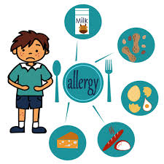



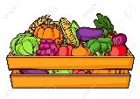

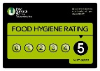















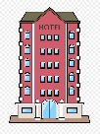


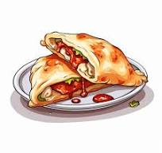

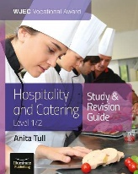

Hospitality and Catering Studies at Cowley
Food related careers
Chef / Baker
Hotel manager
Restaurant manager
Event operations
Nutritionist
Dietician
Food manufacturing
Food Tech
External exam: Unit 1
Personal
safety
AO3: Hospitality health and safety requirements
Further food study
Catering Apprenticeship
Level 3 Food and Nutrition or Hospitality and catering at college
Health and safety
laws
AO1: Know how food can cause ill health
4.5: Symptoms of food related ill health
4.4: Food poisoning
Environmental
concerns in hospitality
4.1: Allergies and intolerances
AO4 homework mock exam questions
3 hour practical exam
Prepare a starter for a brief/target group
Prepare a dessert for a brief/target group
4.2: The environmental health officer
4.3: Food legislation
12 hour Coursework Project
Unit 2:
The coursework
project
Organoleptic qualities
of food
Lemon meringue pie practical
Plan a menu
Prepare a main target brief/group
YEAR
11
Planning a
menu
Homemade beef burgers practical
Dauphinoise potatoes practical
Beef ravioli in tomato sauce practical
Garlic bread plait practical
Culinary trends
Seasonality
Nutrients
2.3 Customer needs
and requirements
Chicken and leek pie practical
Profiteroles practical
Duchesse potatoes practical
De-boning: Chicken goujon SFC practical
Apple turnover practical
AO1: Homework mock exam questions
2.2 Front
of house operations
1.4: Factors affecting business
success
Sweet potato and chorizo soup
1.2: Job roles
Calzone pizza practical
YEAR
Start your KS4 vocational course: Hospitality and Catering
10
AO2: Hospitality operations
Knife skills-coleslaw
Vegetable pasta in sauce practical
1.1 The structure of the hospitality industry
2.1 The kitchen brigade
1.3: employment law
AO1: The hospitality environment
Lemon meringue pie practical

