Slide 1



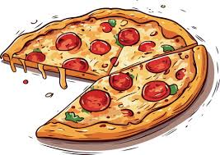
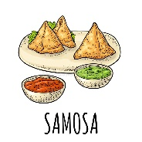
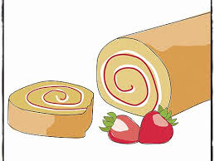

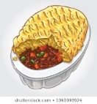











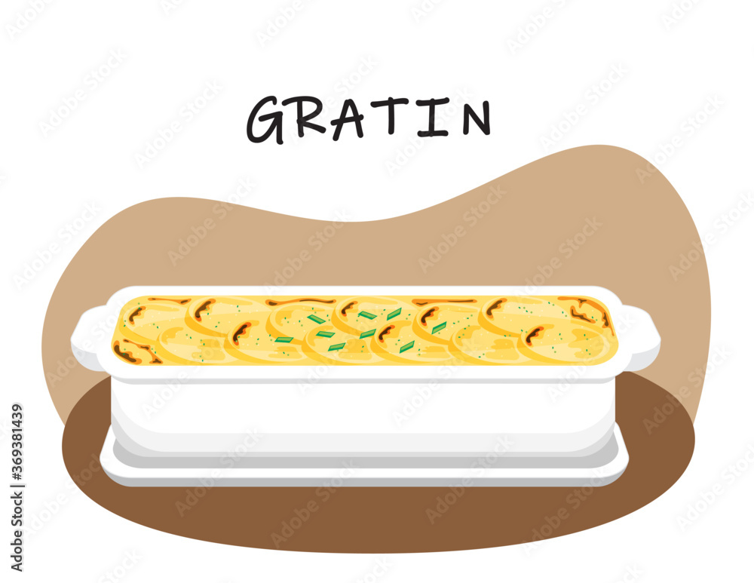





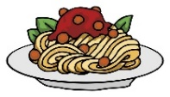




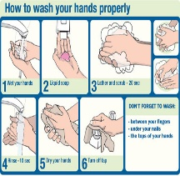

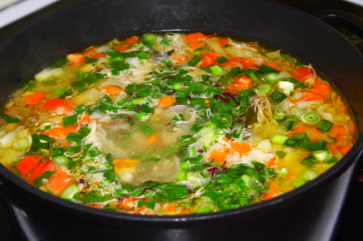
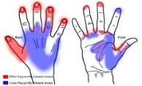

KS3 Food Studies at Cowley
Group practical: ready steady COOK
Types of cooking methods
Practical:
Victoria sponge cake
Practical:
Pizza/base
The function of ingredients
Practical:
Samosa
Prepare for KS4: OPTIONS
Lunchtime practical skills club
Practical:
Swiss roll
Practical:
Chocolate cheesecake
Practical:
Chicken pie
Practical:
Cottage pie
Family meals: Stuffed peppers
Family meals: Healthy Breakfasts
Planning meals on a budget
Nutrition: Micro nutrients, Vitamins and minerals
YEAR
9
Practical:
Omelette
Nutritional deficiencies
Develop creativity and independence in the kitchen
Family meals: Honey raisin oat biscuits
Family meals: Savoury rice
Nutrition: Macro nutrients, Protein
Practical:
carrot cakes
Practical:
Chicken goujons
Practical:
Quesadilla
Risk assessment
Practical:
Bread plait
Nutrition: Macro nutrients, carbohydrates
Family meals: Savoury cheese potatoes
Cultural / world foods
Where our food comes from?
Family meals: Fruit Crumble
Types of restaurants:
Job roles
Family meals: Scones
Family meals: Pasta salad
Family meals: Chicken Curry practical
YEAR
8
Family meals: Sausage casserole
Food Choices: Food Miles
Knife skills: Bolognese practical
Christmas snowball practical
Knife skills: Pitta pizza
Identify risks and hazards in the kitchen
YEAR
7
A balanced diet: The eat well guide
Knife skills: Vegetable soup practical
Introduction to personal and food hygiene.
Lemon meringue pie practical

