Slide 1




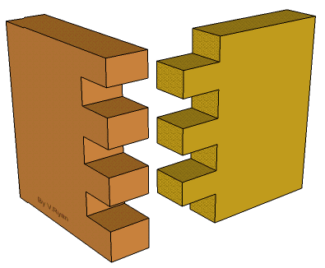
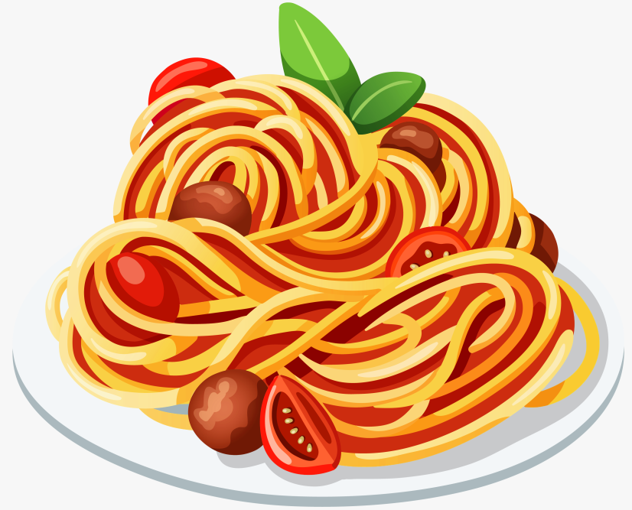
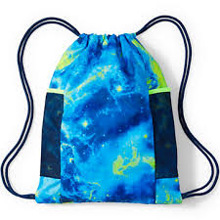


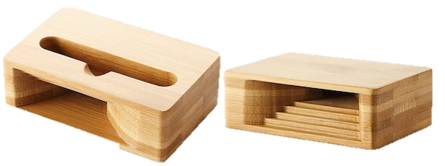
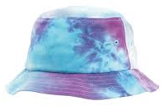
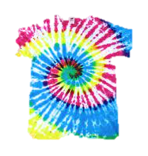
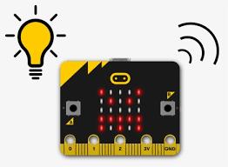




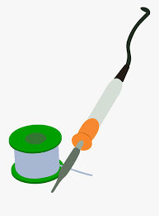
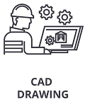
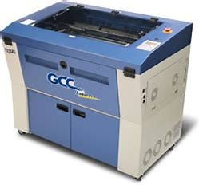
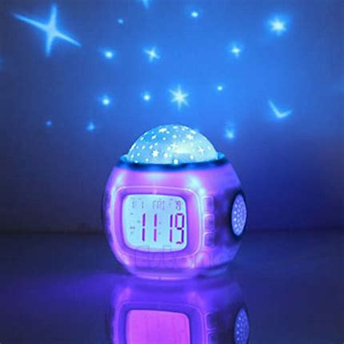
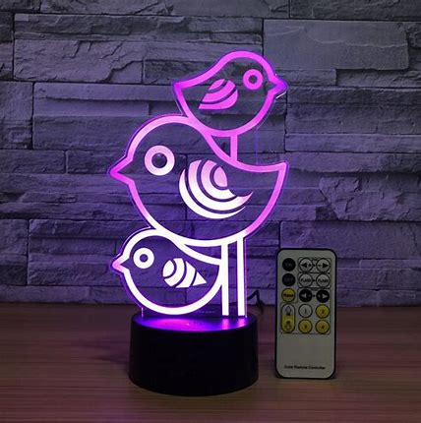
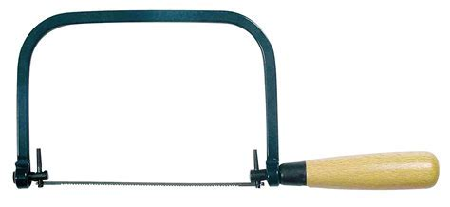

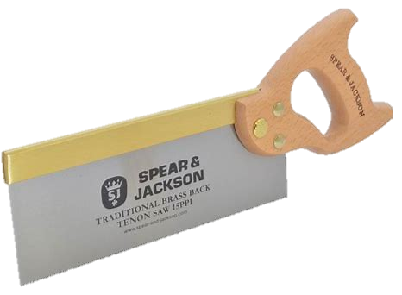
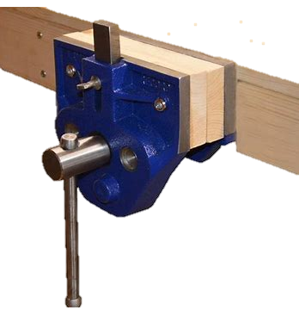
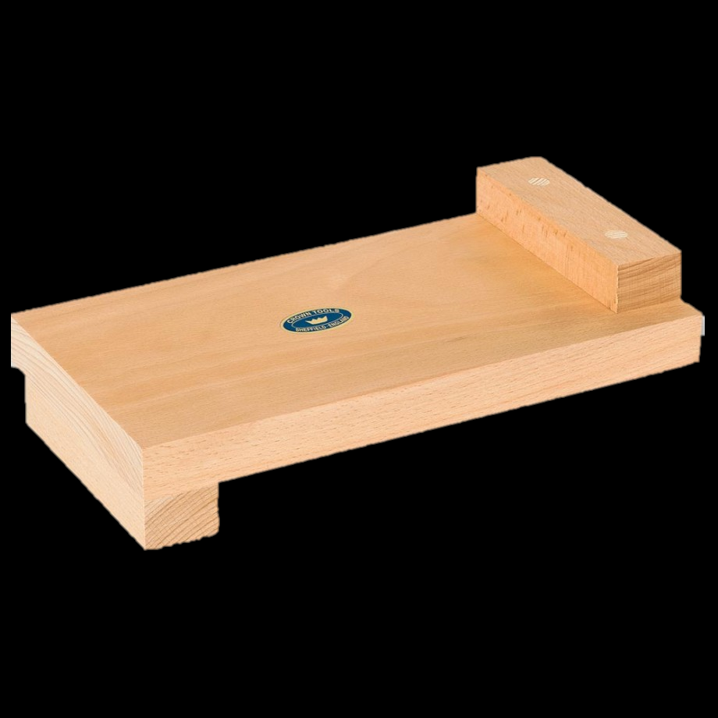
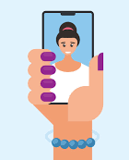
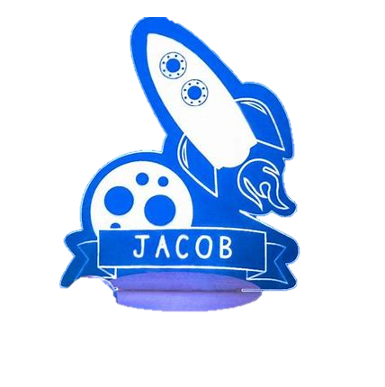
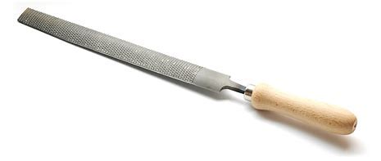
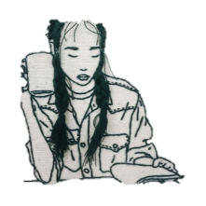
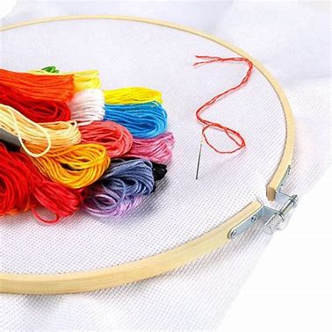
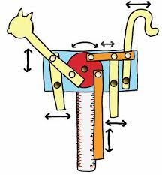
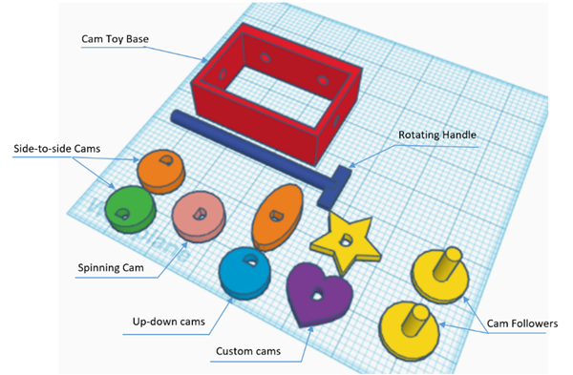
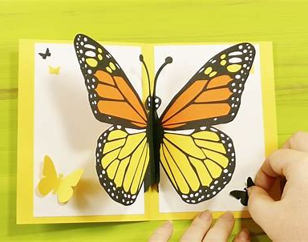



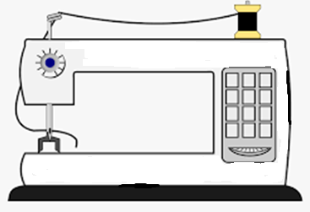
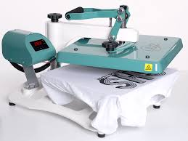


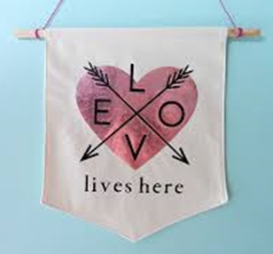





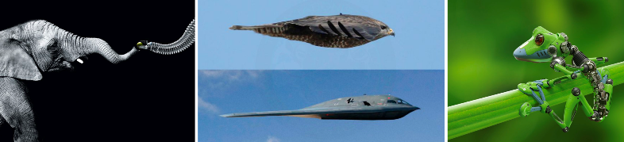
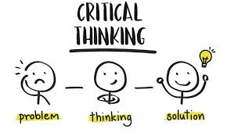
KS3 Design Technology
Learning Journey
Food Practical
Explore your culinary skills by planning and making dishes such as pizza, cottage pie, samosas, chicken pie, cheesecake and Victoria sponge.
Product Design-Wooden Amplifier
Make and modify your own amplifier speaker for your mobile phone. This is then followed with an independent contextual design brief to prepare you for KS4
Textiles Upcycling Revolution: :
Eco festival project
End of KS3 Test
Progression to GCSE 9-1 Design Technology,
L2 Engineering, L2 Textiles, L2 Graphics, L2 Construction, L2 Hospitality and Catering
Evaluation: Evaluation and improvements to the functionality and aesthetics of the products
Graphic Design – Amplifier packaging
Brand your product, come up with a name, logo and slogan for your new product! This is then followed with an independent contextual design brief to prepare you for KS4
Control Systems:
Microcontrollers and embedded intelligence
YEAR
9
Nightlight Packaging: Making skills
Logo, branding and packaging. Hand skills and digital design
Nightlight: Making skills
CAD/CAM, hand tools, laser cutter, circuits, soldering
Design
Produce design ideas & technical drawings to help you plan, both by hand and by CAD
Nightlight: Working to a design brief
Research, design and develop a working nightlight using wood, plastics and electronics.
Nightlight: Make Tasks
Put your design ideas into practice using a range of materials, new tools, equipment and techniques.
Stitch a Selfie:
Drawing with Stitch- Turn your selfie into an embroidered piece of Textiles.
YEAR
Mechanisms. Explore the power of linkages, CAMs, gears and levers through designing and making CAM toys and linkage puppets
8
Mechanisms -Pop-ups
Explore paper engineering and mechanisms through making and illustrating your own book or card. Build on your Graphic skills using CAD programmes and traditional techniques
New Techniques
Computer Aided Design, mechanisms and linkages, machine skills, pattern cutting, transfer printing, tie-dye, laser cutting.
Evaluate your outcomes
Modifications, further developments and improvements
CAD CAM Embroidery
Sustainable Design - Textiles
Positive Vibes banner project
YEAR
7
Graphic Design
An introduction to graphics – colour, typography, logos, branding
Design Task
Design and communicate your ideas through sketching and annotation
Introduction
What is Design Technology?
Career pathways and the industry
Make Task - Prototyping
Bring your designs to life using a range of modelling materials, tools, equipment and techniques to create a prototype of your idea.
Workshop health and safety
Responsible designers, sustainability, materials and biomimicry.

