Slide 1




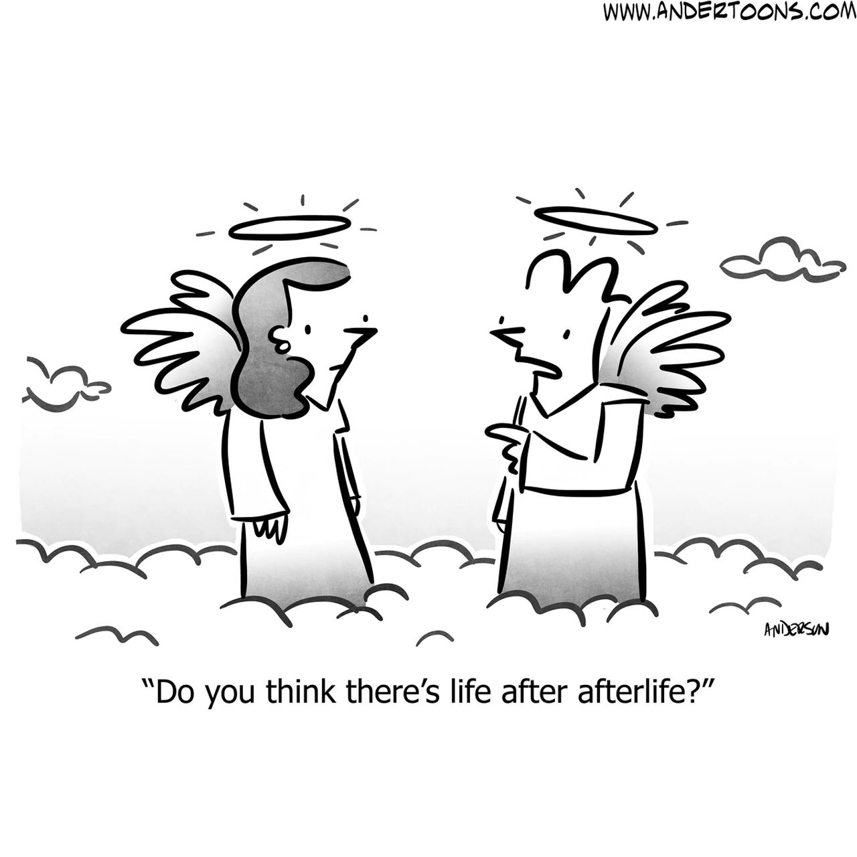


RE KS4 CORE LEARNING JOURNEY
What are alternative religious movements?
Why do we have human rights?
Ultimate questions: Ethics – how do we know what is right and wrong?
Year 11
How ethical is AI?
Should Euthanasia be legal in the UK?
What is the problem of Evil and suffering?
How does belief in the
afterlife impact how we behave?
Year 10

