Slide 1
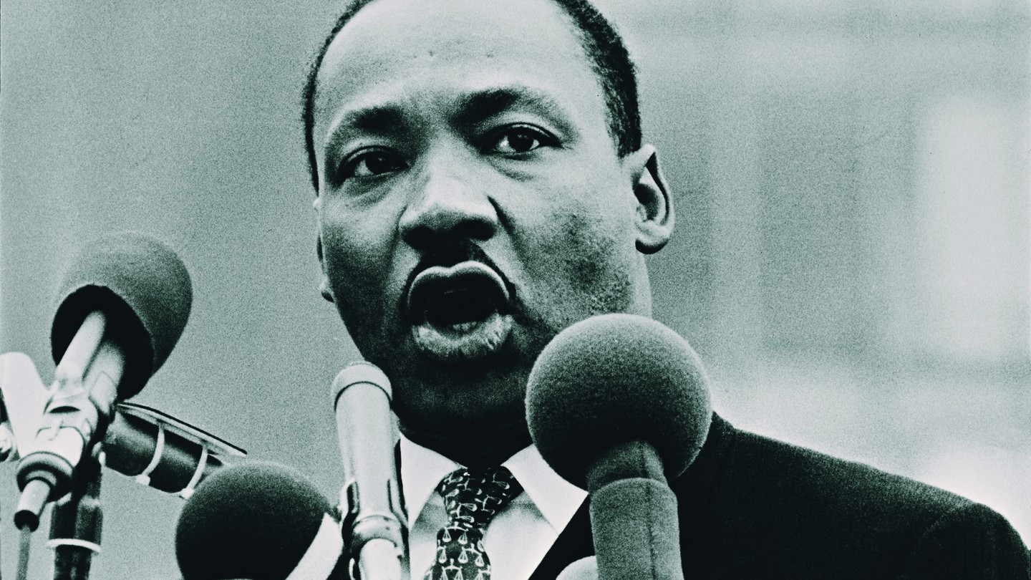
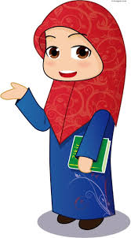
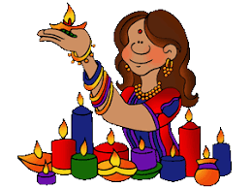
RE KS3 LEARNING JOURNEY
14. What are attitudes towards abortion?
Ready for GCSE
15. What are religious attitudes towards violent and nonviolent protest?
13. What are attitudes towards crime and punishment?
Year 9
12. How do Hindu beliefs about the afterlife affect their lives?
11. Where do Christians find guidance in their lives?
10. How do Jewish practices affect their lives?
7. What is truth?
8. Does God exist?
6. What is Buddhism?
9. Do Muslim beliefs help them to live good lives?
Year 8
2. How did Judaism begin?
4. What unites the Ummah?
Year 7
5. What beliefs unite the Hindu community?
3. Why do people follow Jesus today?
1. To what extent is religion important today?

