Slide 1




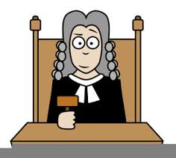

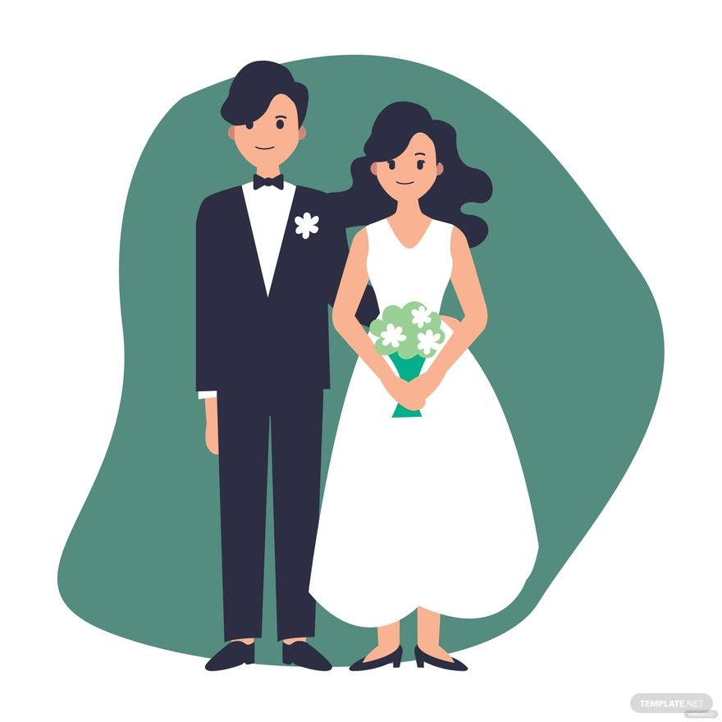





Ethics and Philosophy GCSE LEARNING JOURNEY
Issues of Human Rights:
Human Rights and Social Justice/ Censorship/ Freedom of religious expression/ Religious Extremism/ Prejudice and Discrimination/ Wealth and Poverty
Ready for A-Level
Issues of Life and Death:
Origin of the universe/ Origin and value of human life/ Abortion/ Euthanasia/ Afterlife
Issues of Good and Evil:
Crime and Punishment/ Death Penalty/ Forgiveness/ Good, Evil and Suffering
Issues of Relationships:
Family/ Marriage/ Cohabitation/ Divorce & Separation/ Sexual Relationships/ Gender Prejudice & Discrimination
Year 11
Islam Practices:
The Five Pillars of Islam/ Jihad/ Festivals and Commemoration/ The 10 Obligatory Acts of Shi’a Islam
Islam Beliefs and Teachings:
Foundations of Faith/ Nature of Allah/ Prophethood/ Angels/ The Afterlife
Christianity Beliefs and Teachings:
Nature of God/ Creation/ Jesus Christ/ Salvation/ The afterlife
Year 10
Christianity Practices:
Forms of Worship/ The Sacraments/ Pilgrimage and Celebrations/ Christianity in Britain/ The Worldwide Church

Slide 2
RE KS4 GCSE LEARNING JOURNEY
Issues of Human Rights:
Human Rights and Social Justice/ Censorship/ Freedom of religious expression/ Religious Extremism/ Prejudice and Discrimination/ Wealth and Poverty
Ready for A-Level
Issues of Life and Death:
Origin of the universe/ Origin and value of human life/ Abortion/ Euthanasia/ Afterlife
Issues of Good and Evil:
Crime and Punishment/ Death Penalty/ Forgiveness/ Good, Evil and Suffering
Issues of Relationships:
Family/ Marriage/ Cohabitation/ Divorce & Separation/ Sexual Relationships/ Gender Prejudice & Discrimination
Year 11
Islam Practices:
The Five Pillars of Islam/ Jihad/ Festivals and Commemoration/ The 10 Obligatory Acts of Shi’a Islam
Islam Beliefs and Teachings:
Foundations of Faith/ Nature of Allah/ Prophethood/ Angels/ The Afterlife
Christianity Beliefs and Teachings:
Nature of God/ Creation/ Jesus Christ/ Salvation/ The afterlife
Year 10
Christianity Practices:
Forms of Worship/ The Sacraments/ Pilgrimage and Celebrations/ Christianity in Britain/ The Worldwide Church

