Slide 1
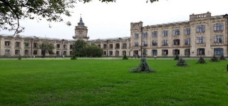
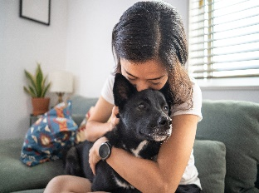
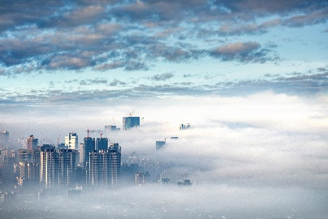
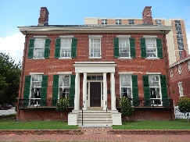
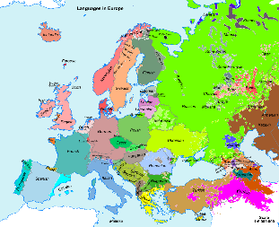
French and German KS4 - LEARNING JOURNEY
GCSE EXAMS
Term 3
12. Studying and My Future
Getting a job, future aspirations
11. Studying and My Future
Talking about future studies
Mocks 2
Term 2
10. Studying and My Future
Job aspirations, preferences
Speaking Mocks Re-sits
DETAILED REVISION
Mocks 1
Speaking Mocks 1
YEAR 11 GERMAN / FRENCH
7. Studying and My Future
Describing your school
8.Studying and My Future
Giving detailed information about what you learn
9.Studying and My Future
Progress at school, School Memories
Term 1
Year
11
6.Media and Technology
Social Media/Gaming, Music, TV/Film
10. Life at school
Describing your day, routines, uniform
5.Lifestyle and Wellbeing
Physical well being/mental wellbeing
Term 3
3. My Neighbourhood
Local issues and actions, Understanding infographics about environment
4. Environment
environmental problems and solutions
YEAR 10 GERMAN / FRENCH
2. Travel and Tourism
Accommodation,
Festivals, Tourist Attractions
Term 2
Year
10
Year
10
Term 1
1.My Personal World/Neighbourhood
Family, Friends Relationships, Equality, Places in Town, Shopping

