Slide 1





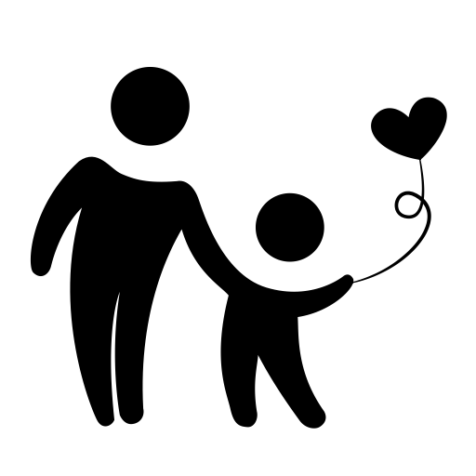
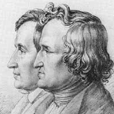

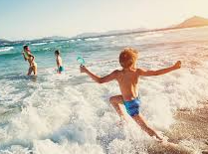
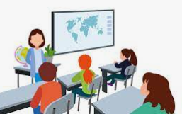
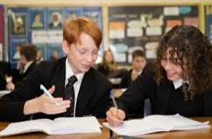



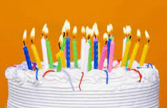
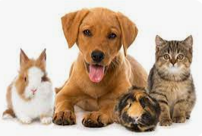


17. Rights and Responsibilities
Writing a Critique on a German Film using three tenses
Talking about age limits, what is important to us, comparing life earlier and now, how we can make a difference and how we can find happiness
18. A Culture Project
GCSE
14. Wild about music
16. Childhood
15. My Ambitions
Talking about childhood activities,Grimm’s fairy tales and comparing primary school with secondary school
Talking about different types of music, discussing different bands and describing a music festival
Talking about crazy ambitions, reasons for doing jobs, what you would like to do in the future and work experience in a ski resort
13. My Role Model
Talking about role models, experiences and how to overcome
misfortunes
12. A Cultural Project
Learning about our Twin town, festivals and the film ‘Miracle of Bern’
11. Weather and global issues
Describing weather conditions in general and on holiday, looking at global issues
Year 9
10. Holidays
7. School
8. In the classroom
Activities on holiday, saying what your plans are
Talking about school subjects, clothes and uniform. Discussing your timetable and describing teachers
Describing your classrooms and talking about school rules
6. Online activities
Saying what you do online, using time markers and the future tense
Year 8
9. Town
Describing what is in your town, saying what you like to buy (shopping), food and drink, healthy living
5. Sports, free-time
What sports you like, dislike, talking about leisure activities
2. Your character and favourite things
Describing your character, saying what your favourite things are
Year 7
4.Describing family, birthdays
Understanding and writing about family members, talking about birthdays
1. My World
3. Talking about yourself, family and pets
Information about pets, introducing family, looking at personalities, ages
Introducing yourself, the alphabet, learning numbers and saying where you live

