Slide 1
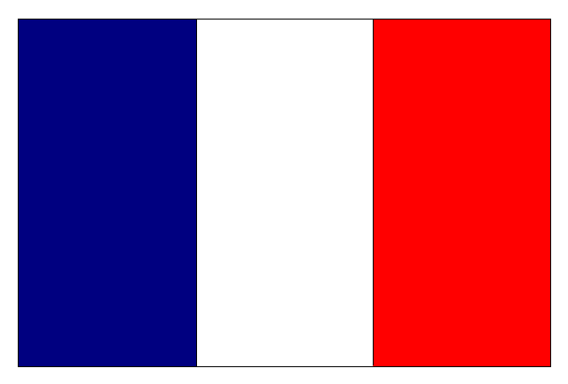




17. Film Study
A la Folie- Film
Writing a critique on film using three tenses
GCSE
Giving opinions on sports, using the comparative, asking for and giving directions, talking about injuries and illness, parts of the body
15. Daily Routine
16. Sport
14. Leisure time
Discussing weather, daily routine, where you live
Using three tenses in writing
How spend my leisure time - watching TV, cinema, eating out, using digital technology
13. Festivals
Talking about festivals and celebrations in France
Buying food at the market
Talking about a past/future trip
12. Holidays
Talking about school holidays
Saying what activities you did on holiday,
Using a variety of tenses
11. Film Study/Cultural Events
Tour de France,
Les Misérables- French Revolution
Fête de La Musique
Year 9
7.Family Life
Talking about pets, describing your family,
Using possessive adjectives,
Describing where you live
8.Meal times
10.Town/City
Talking about breakfast
Ordering snacks in a café
Introducing the past tense
Cultural Lessons on Christmas in France
Describing places in town
Using 3 tenses to describe your town
6. Film Study
“La vie d’un Chat”
Le 14 juillet
Year 8
9. Town/City
Cultural Study of Paris
Introducing the Future tense
5. Free Time
Weather and seasons,
Know how to use verb faire/ jouer
Sports
2. Yourself and Family
Know how to describe yourself and others,
What activities you like to do
Year 7
4. School
1. Introduction
to French
Differences between French and British schools,
La Francophonie
3. School
School subjects- likes/dislikes
Telling the time/school uniform
Greetings, introducing yourself, France fun facts

