Slide 1
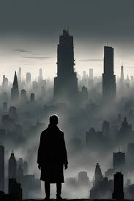
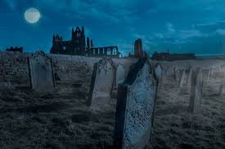
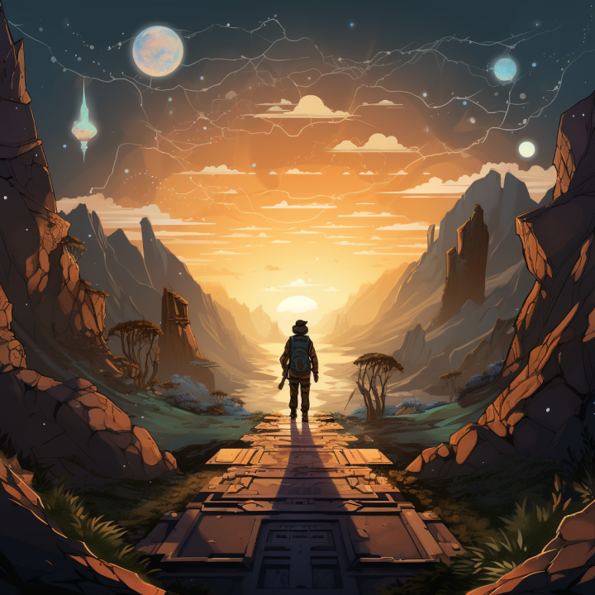
Key Stage 3 English
LEARNING JOURNEY
15. Poetry
Romantic Poetry
Poetry Analysis
14. Prose: The Power of Stories
Dystopia Narrative
Writing
13. Non-fiction: Gaming Rhetoric
Analysing
& writing
speeches
Ready for GCSE
End of year exams
11. Prose Novel:
Animal Farm
Extract Analysis
Analysing Language & Character
12. Drama: Shakespeare Romeo & Juliet Introduction to Tragedy
Analysing
Shakespeare’s
Language
Year 9
Year 8
AR SUMMER
Reading Target
Achieved? ☑
9. The Gothic
Response to Enlightenment
Industrial Revolution
Science and development
Fiction and non-fiction
Transactional Writing
Year 8
AR SPRING
Reading Target
Achieved? ☑
8. Drama: Shakespeare
The Tempest
Power & The Supernatural
Analysing Shakespeare’s Language
End of year exams
10. The Gothic
Gothic Prose Descriptive writing
7. Poetry
Nature Poetry
Poetic Forms
Poetic Terms
5. Journey and Adventure
Fiction
Creative Writing
Year 7
AR SUMMER
Reading Target
Achieved? ☑
Year 8
AR AUTUMN
Reading Target
Achieved? ☑
Year 8
End of year exams
6. Prose Novel: Trash
Character Analysis
Analysing Language & Structure
4. Journey and Adventure
The origins of stories
Non-fiction, Transactional Writing
2. Poetry
People and Places Poetic form
Poetic terms
Year 7
AR SPRING
Reading Target
Achieved? ☑
Year 7
3. Drama:
Introduction to Shakespeare
The language of Elizabethan England
Year 7
AR AUTUMN
Reading Target
Achieved? ☑
1. Prose Novel:
Once
Narrative structure
Narrative Writing

